Slide 1

Администрирование Apache Spark

Slide 2
Практика
Модуль 4
Преподаватель: БАСОВ ЮРИЙ

Slide 3
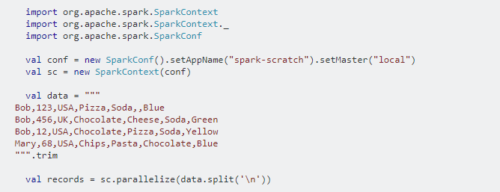
Сгруппируйте имя и блюдо

Slide 4
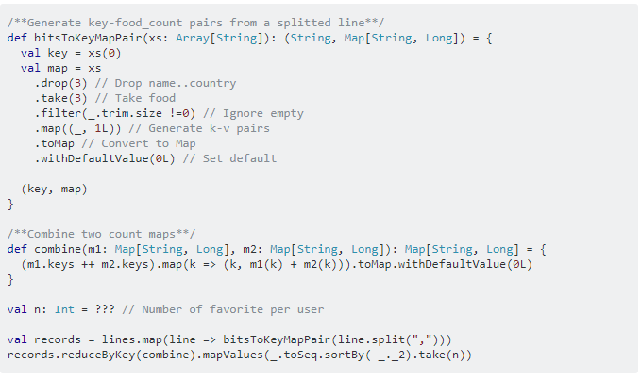
Выведите заказ в файл

Slide 5

Вопросы?

Slide 6

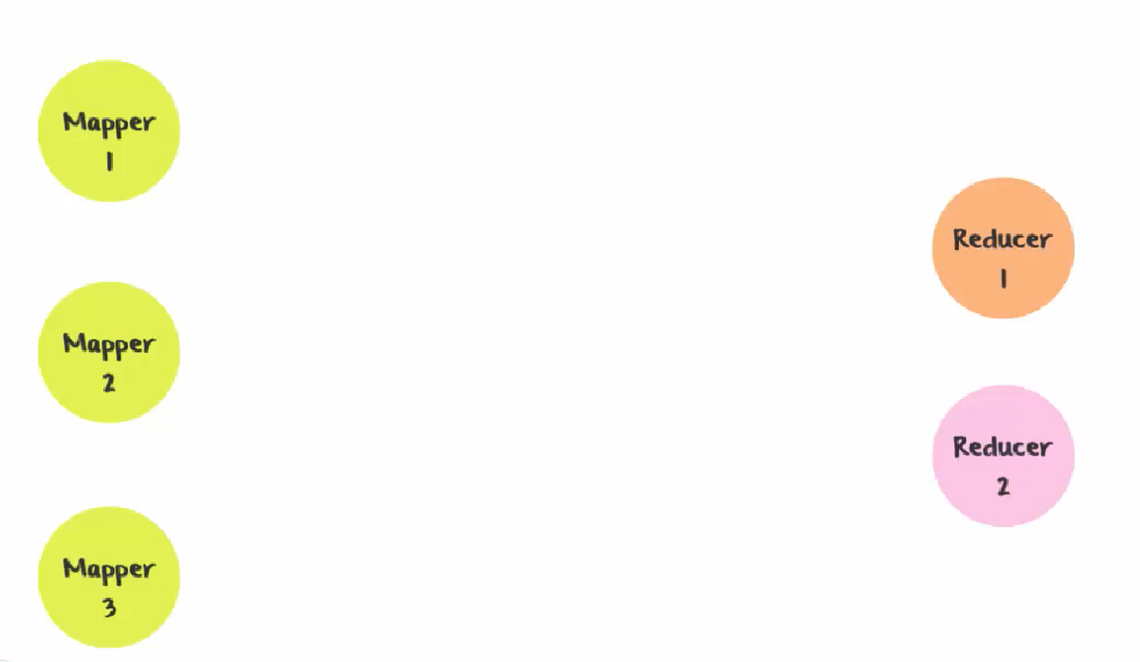
Почему происходит перемешивание?

Slide 7
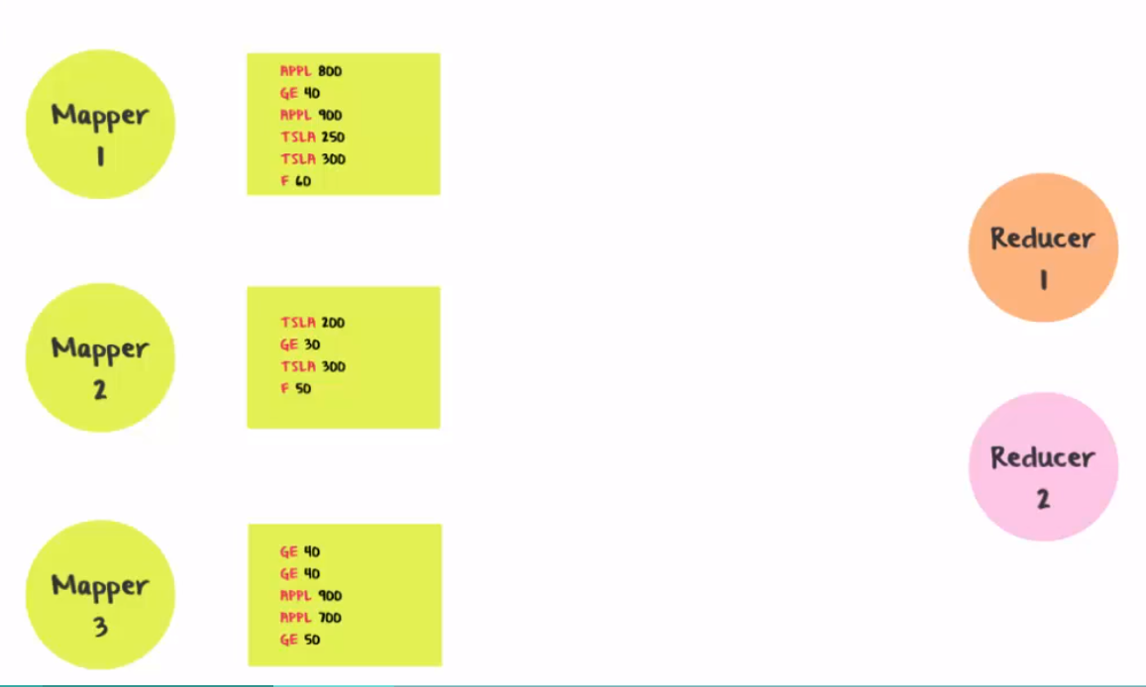
Почему происходит перемешивание?

Slide 8
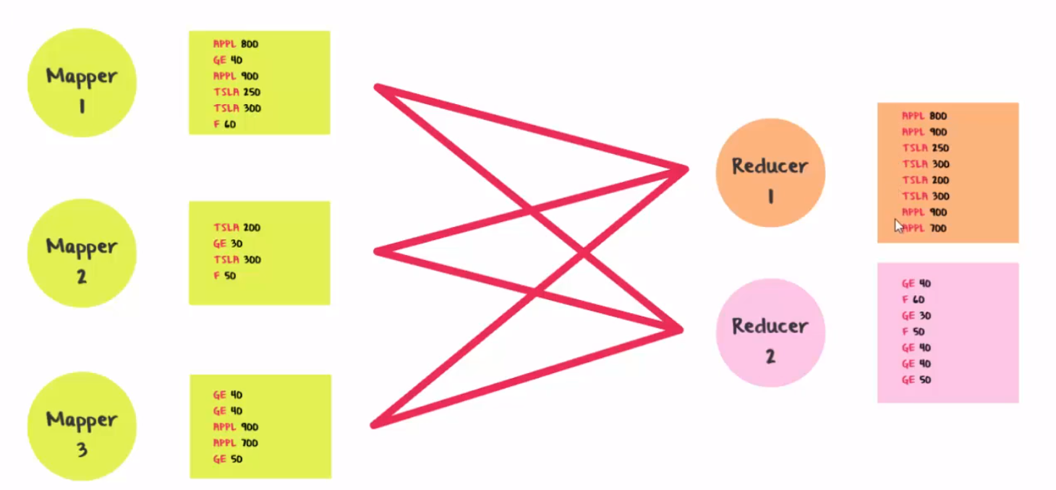
Почему происходит перемешивание?

Slide 9
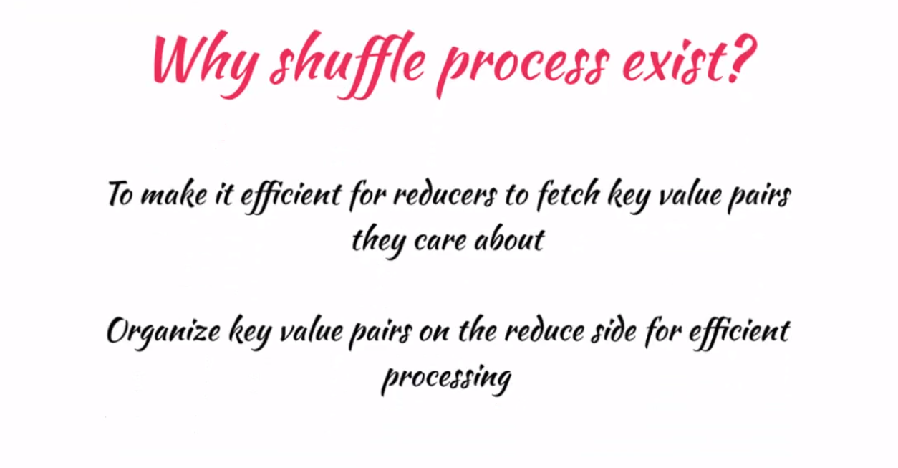
Почему происходит перемешивание?

Slide 10
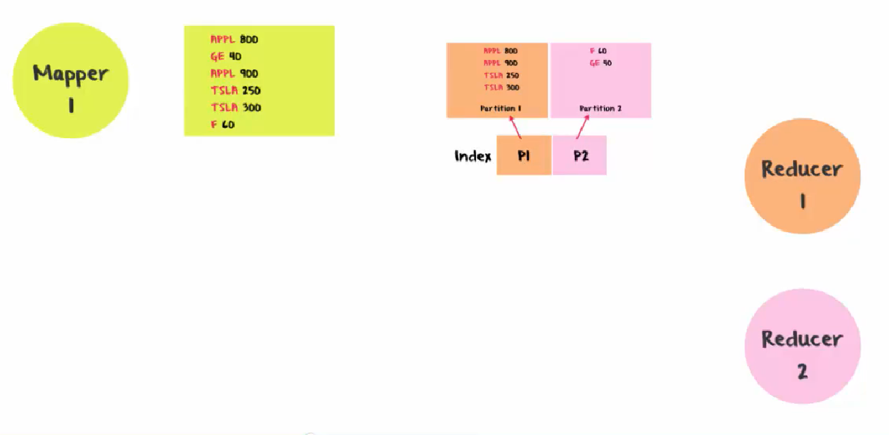
Перемешивание на Hadoop

Slide 11
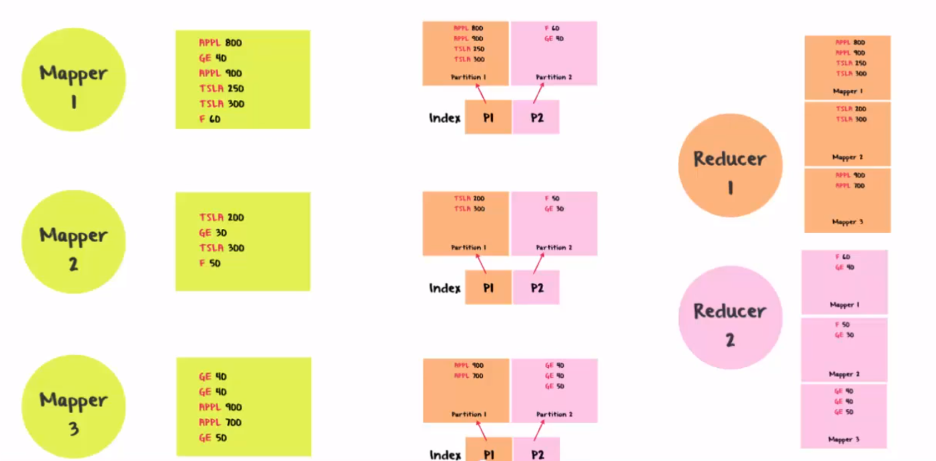
Перемешивание на Hadoop

Slide 12
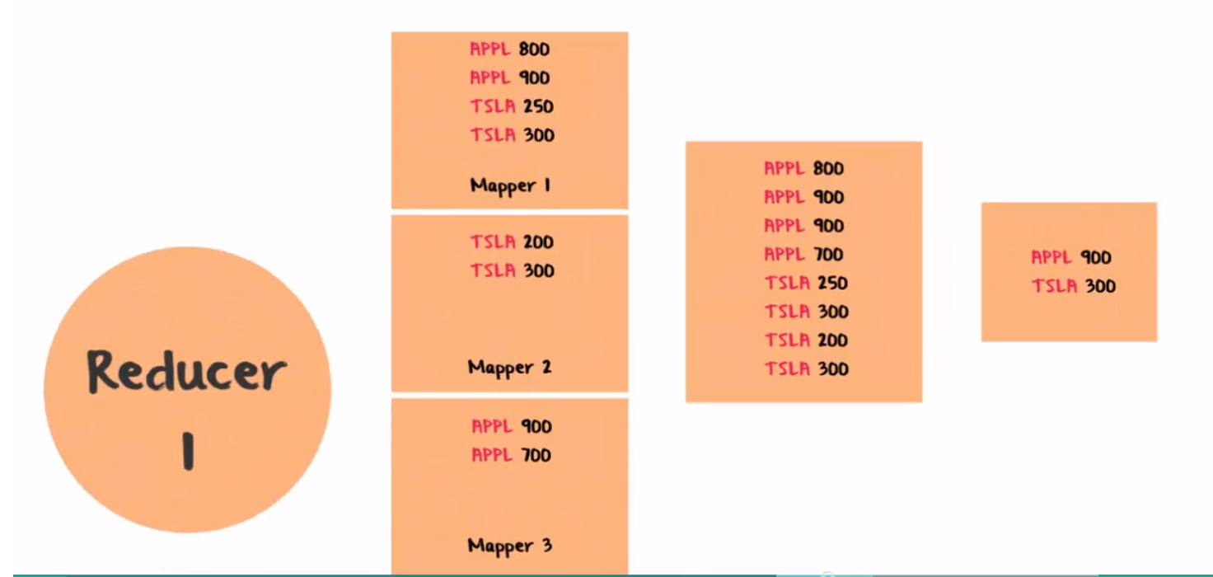
Перемешивание на Hadoop

Slide 13
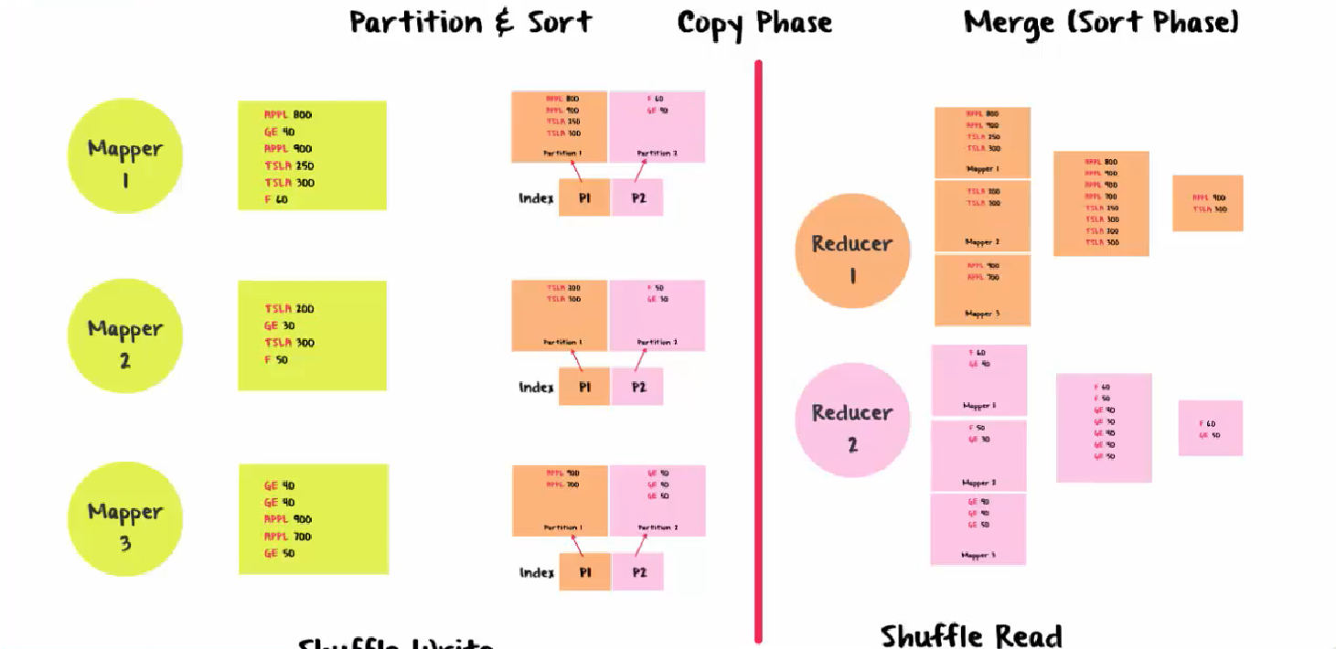
Перемешивание на Hadoop

Slide 14
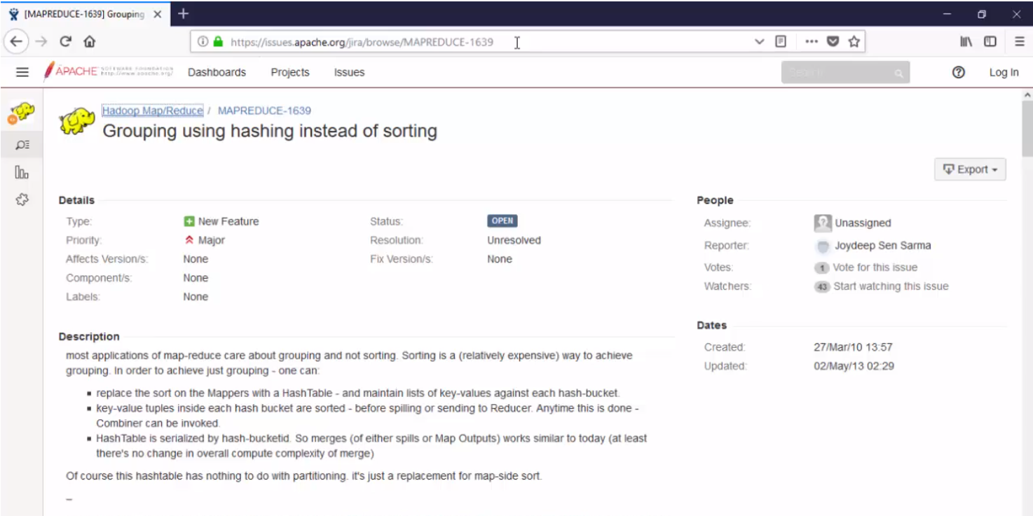
Перемешивание на Hadoop

Slide 15

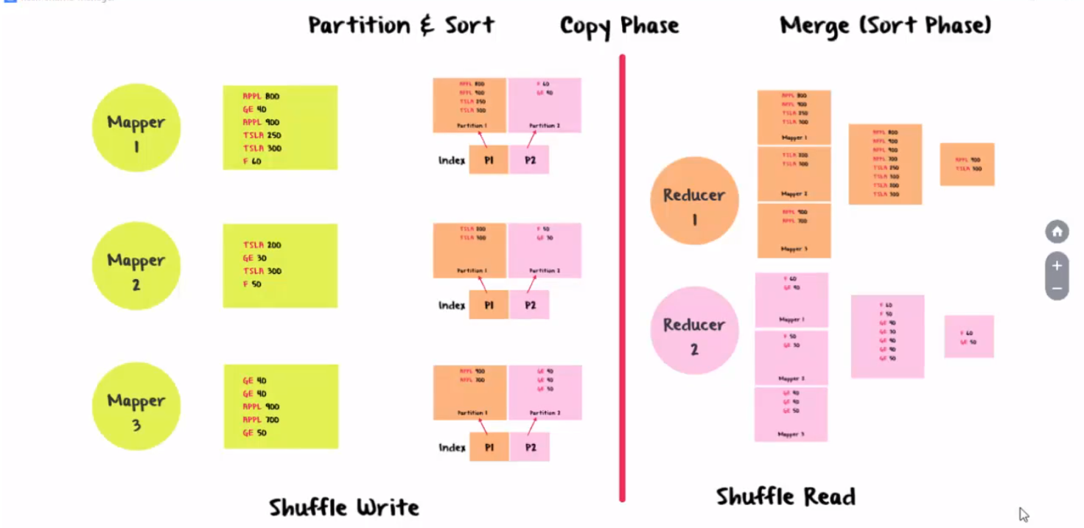
Hash Shuffle Manager в Spark (часть 1)

Slide 16
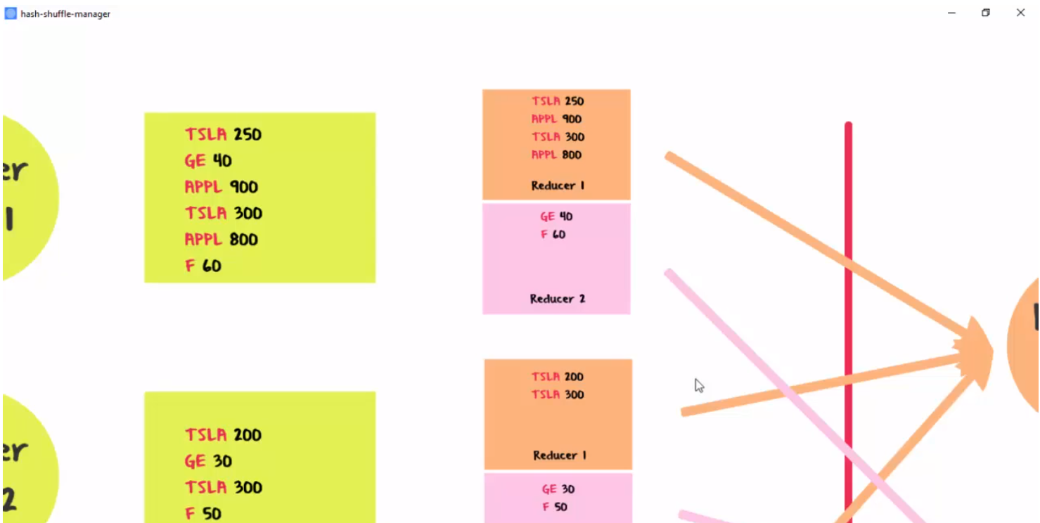
Hash Shuffle Manager в Spark (часть 1)

Slide 17
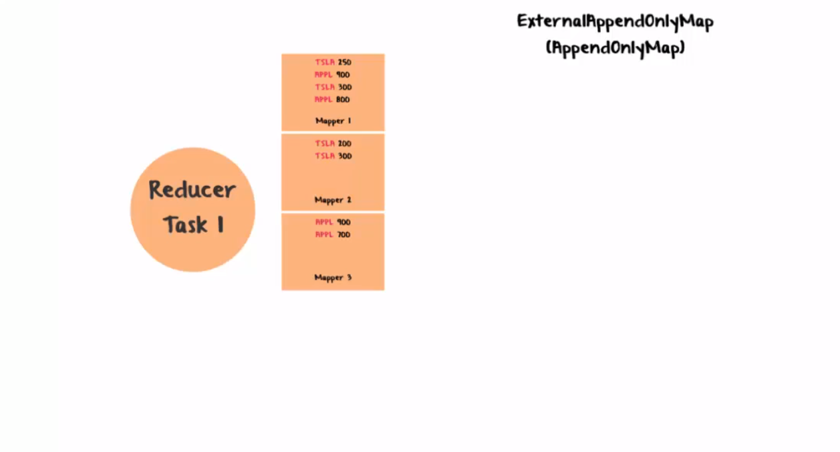
Hash Shuffle Manager в Spark (часть 1)

Slide 18
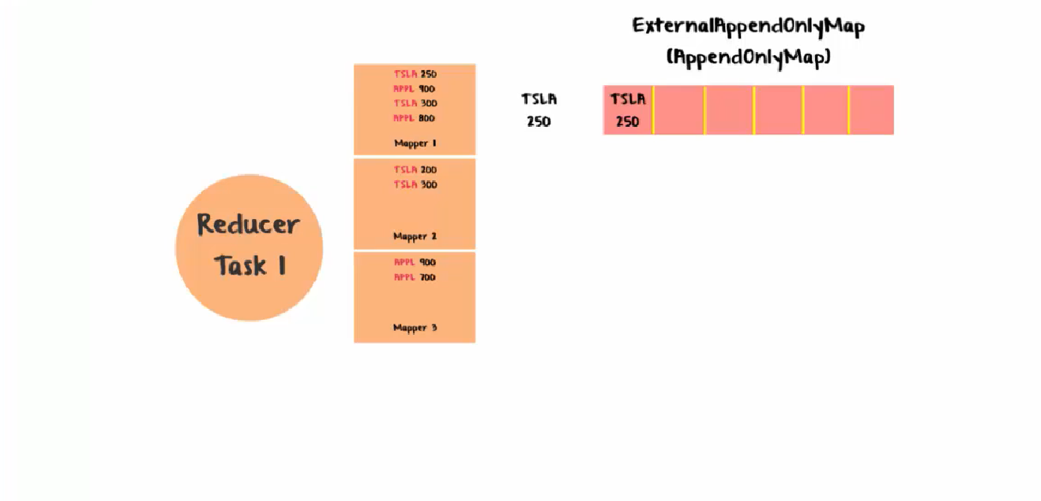
Hash Shuffle Manager в Spark (часть 1)

Slide 19
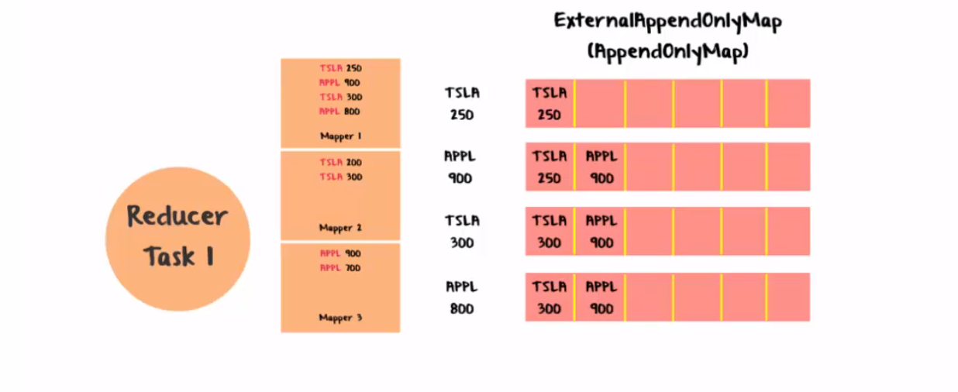
Hash Shuffle Manager в Spark (часть 1)

Slide 20
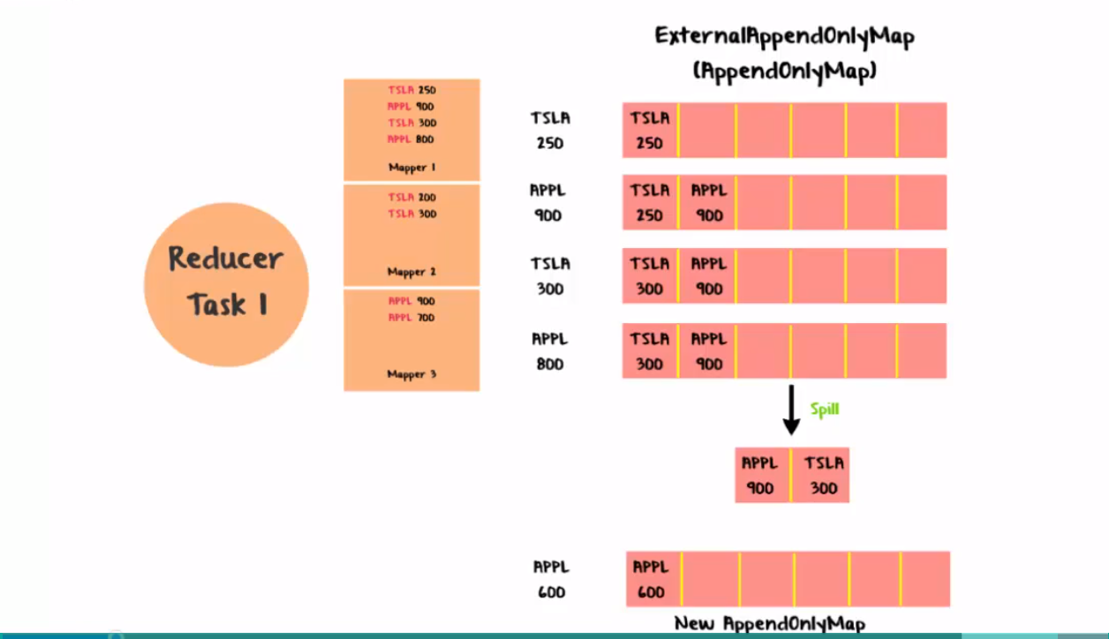
Hash Shuffle Manager в Spark (часть 1)

Slide 21

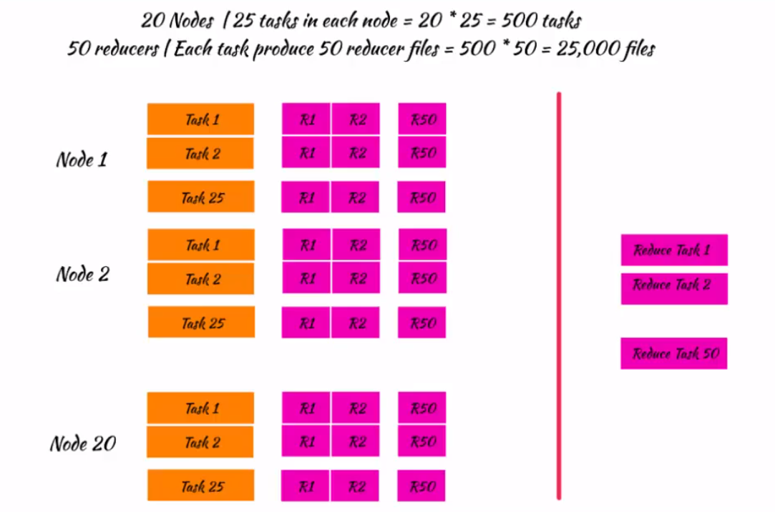
Hash Shuffle Manager в Spark (часть 2)

Slide 22

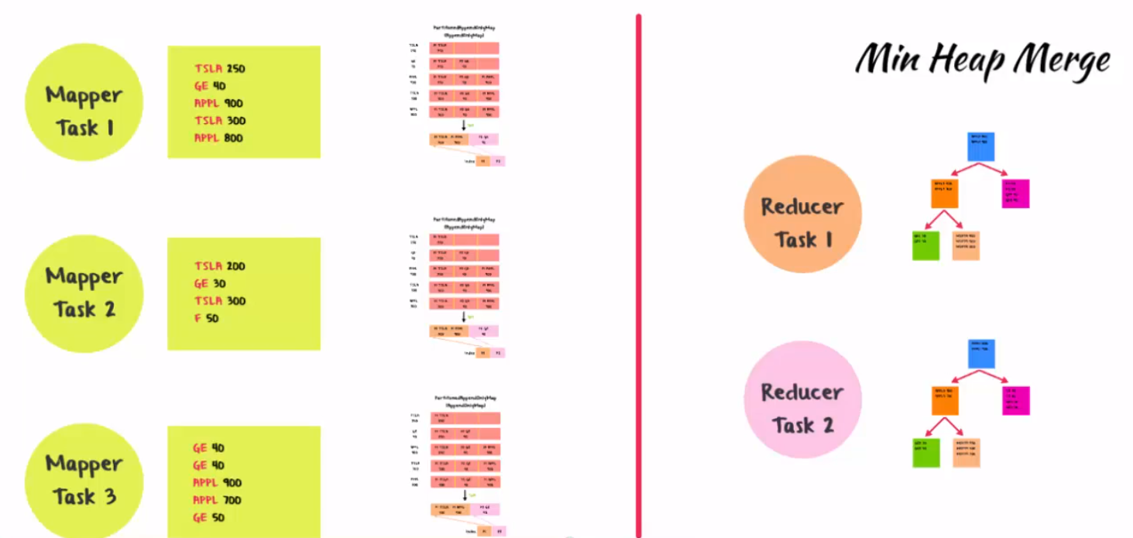
Soft Shuffle Manager в Spark

Slide 23

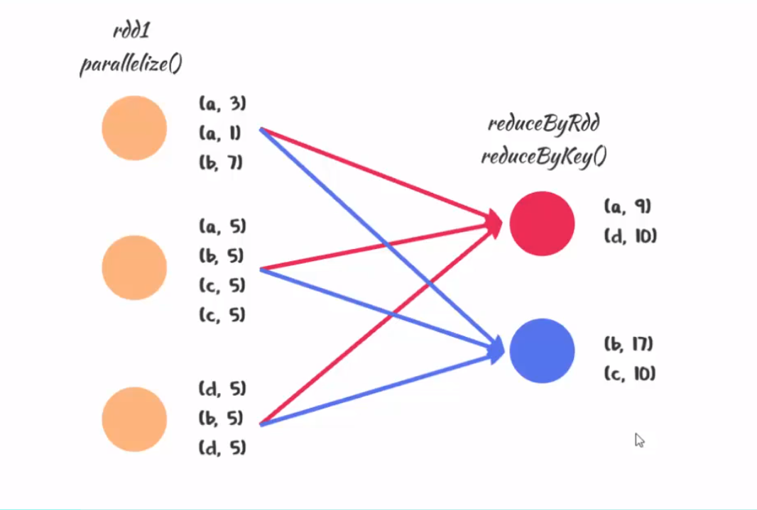
Reduce By Key и Group By Key

Slide 24
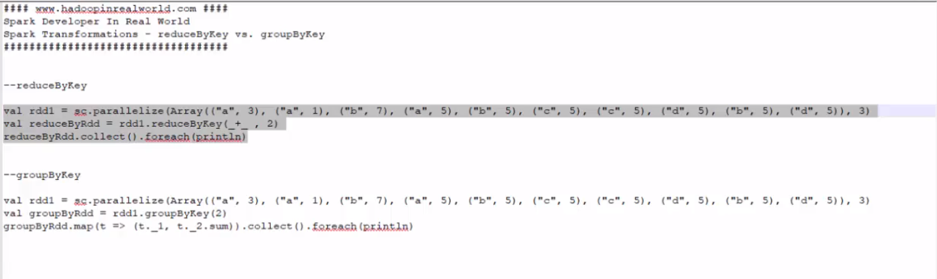
Reduce By Key и Group By Key

Slide 25
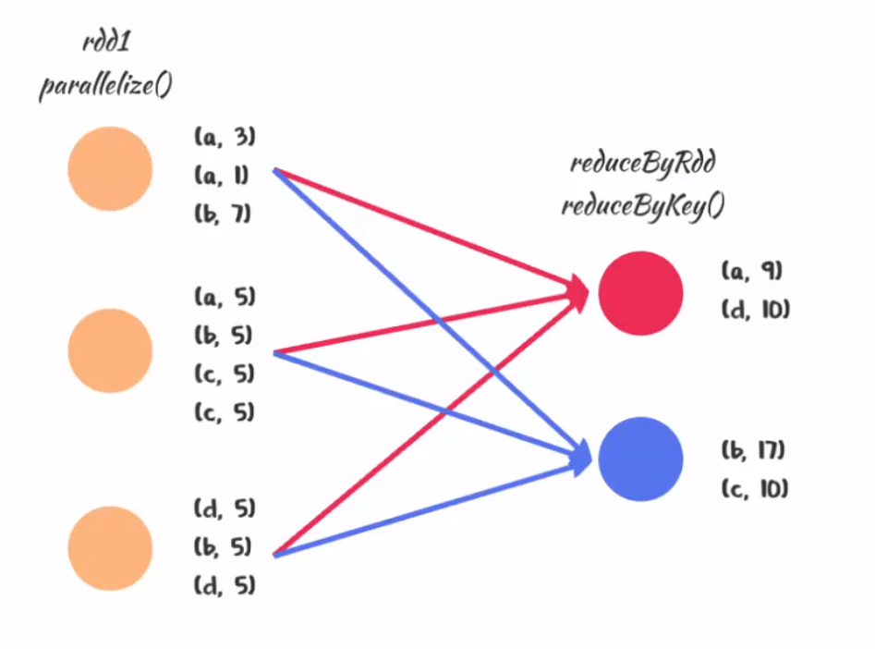
Reduce By Key и Group By Key

Slide 26
Reduce By Key и Group By Key

Slide 27
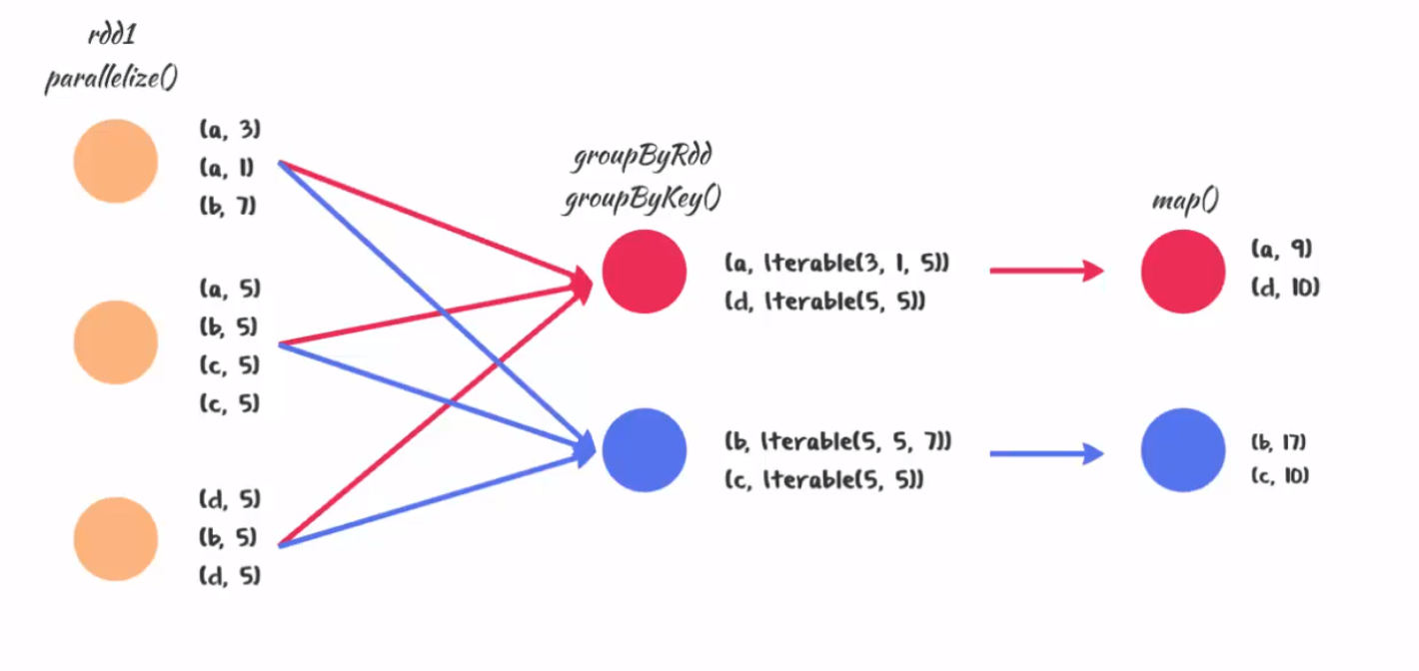
Reduce By Key и Group By Key

Slide 28
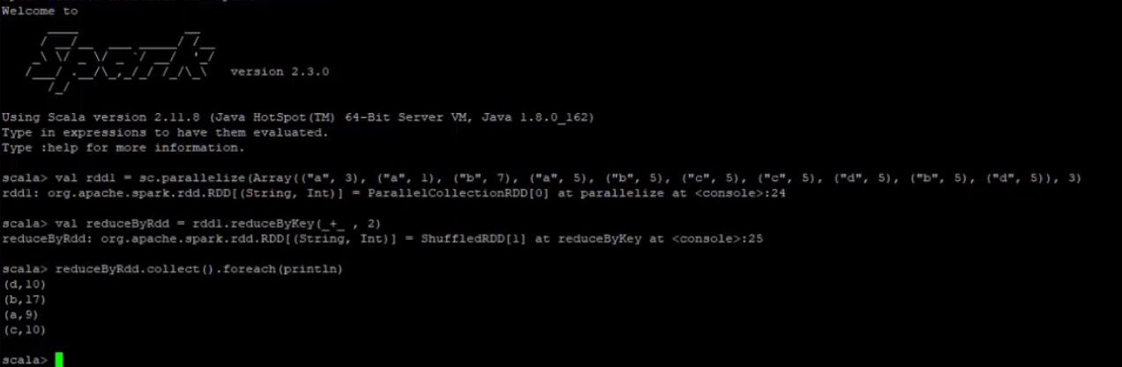
Reduce By Key и Group By Key

Slide 29
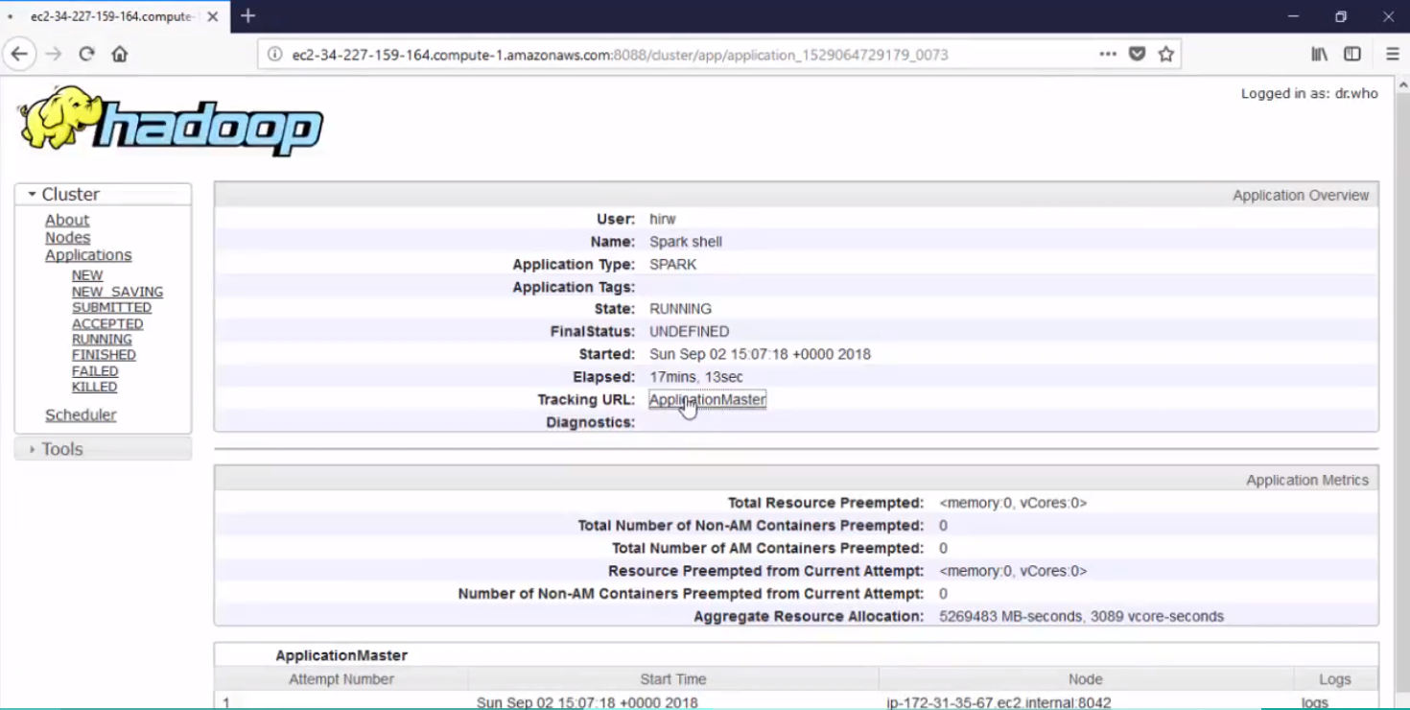
Reduce By Key и Group By Key

Slide 30
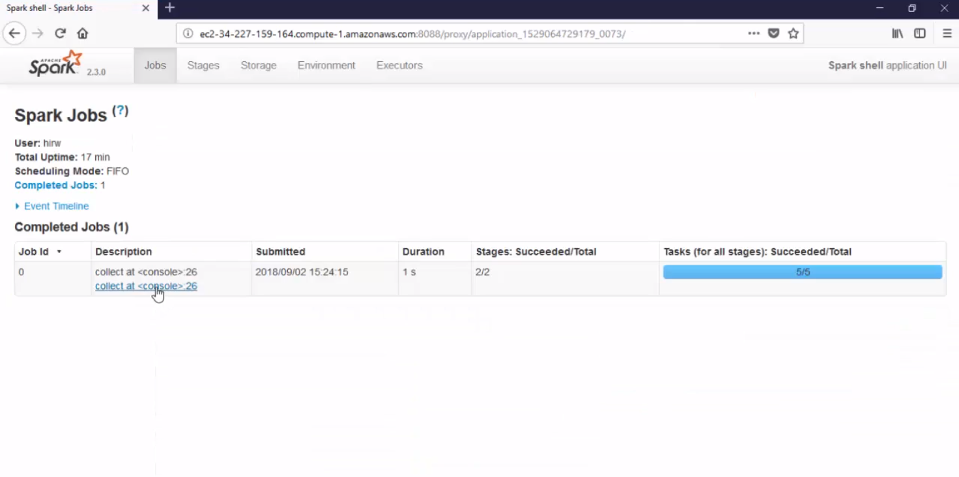
Reduce By Key и Group By Key

Slide 31
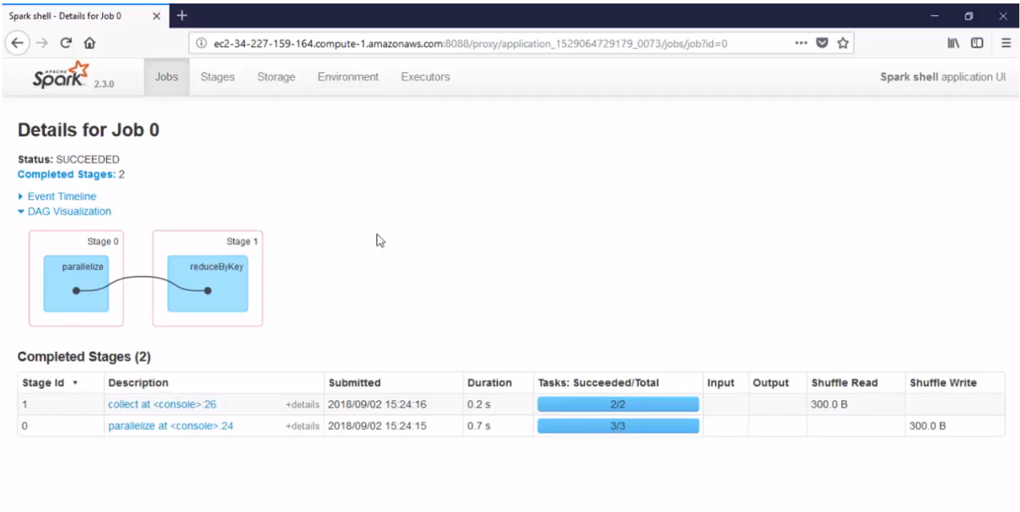
Reduce By Key и Group By Key

Slide 32
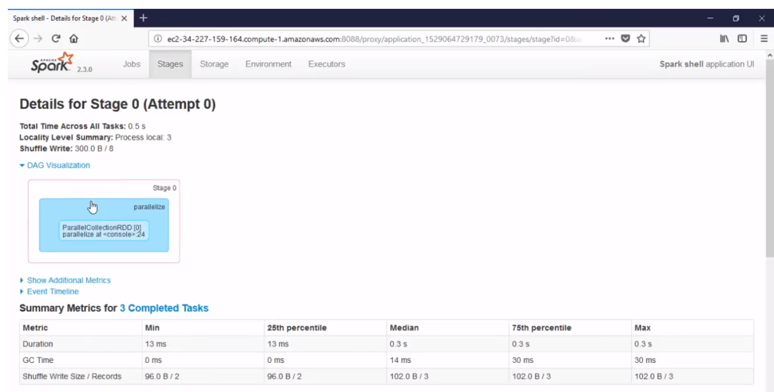
Reduce By Key и Group By Key

Slide 33
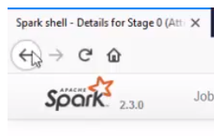
Reduce By Key и Group By Key

Slide 34
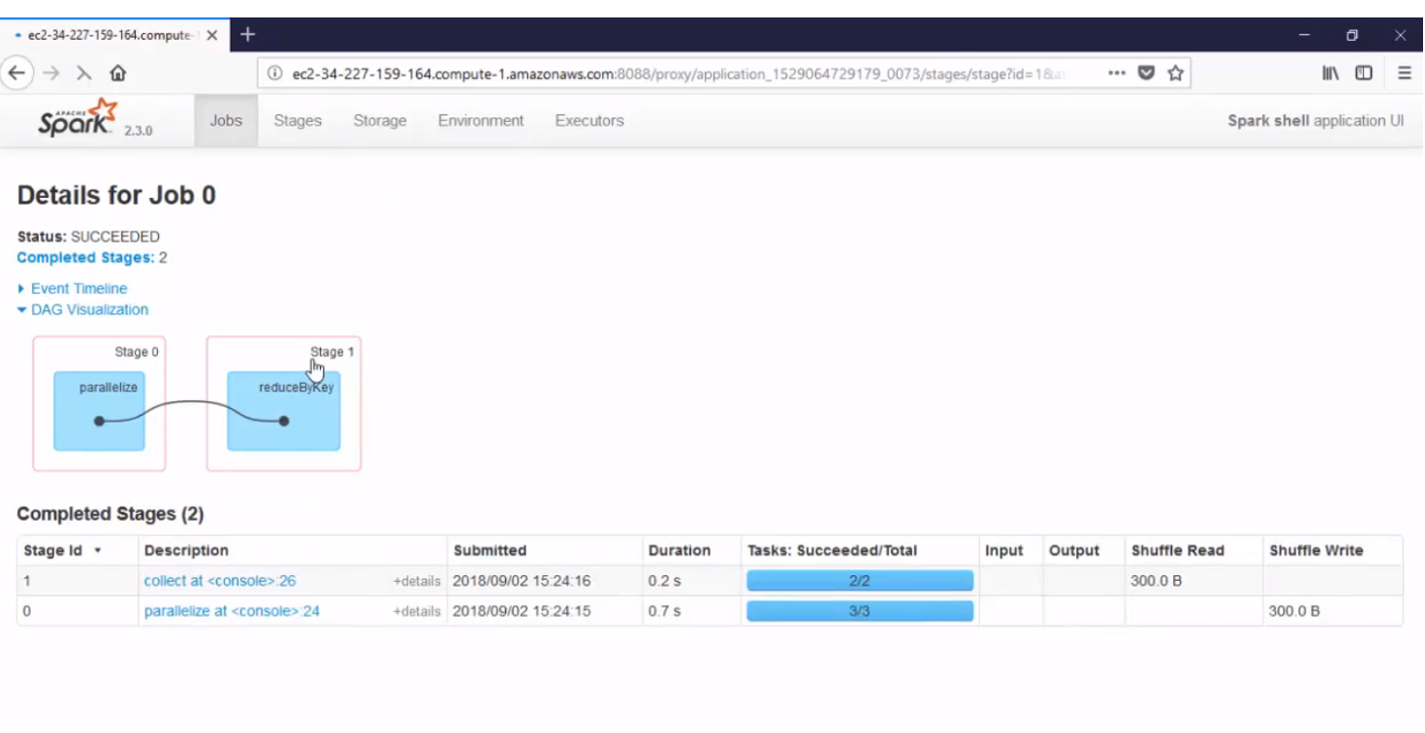
Reduce By Key и Group By Key

Slide 35
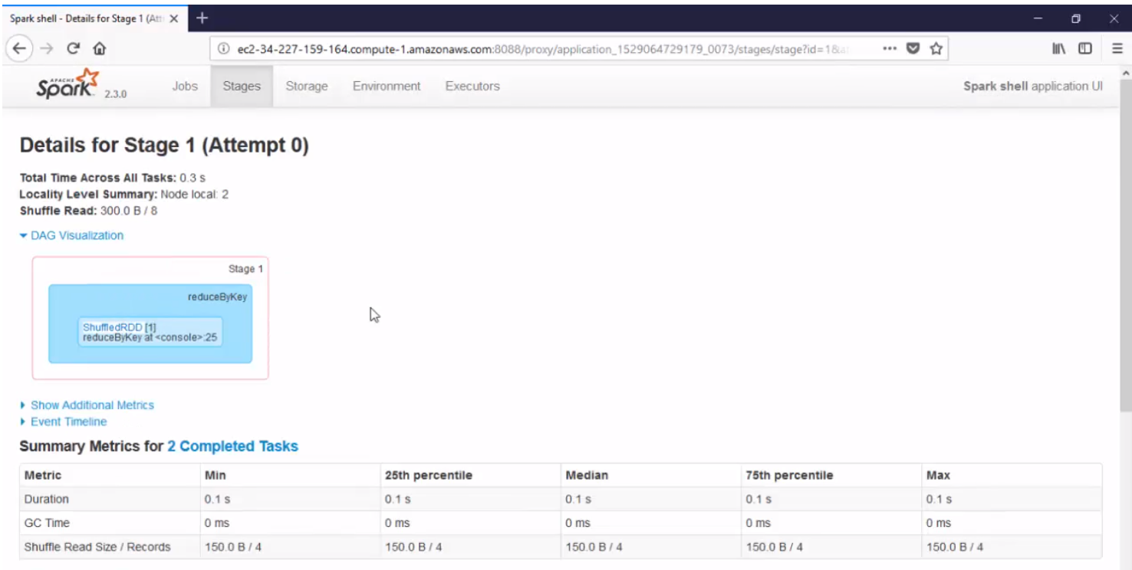
Reduce By Key и Group By Key

Slide 36
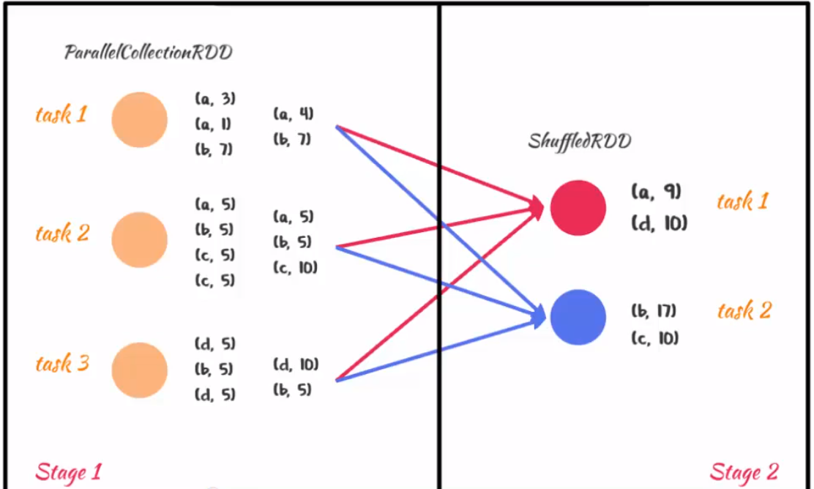
Reduce By Key и Group By Key

Slide 37
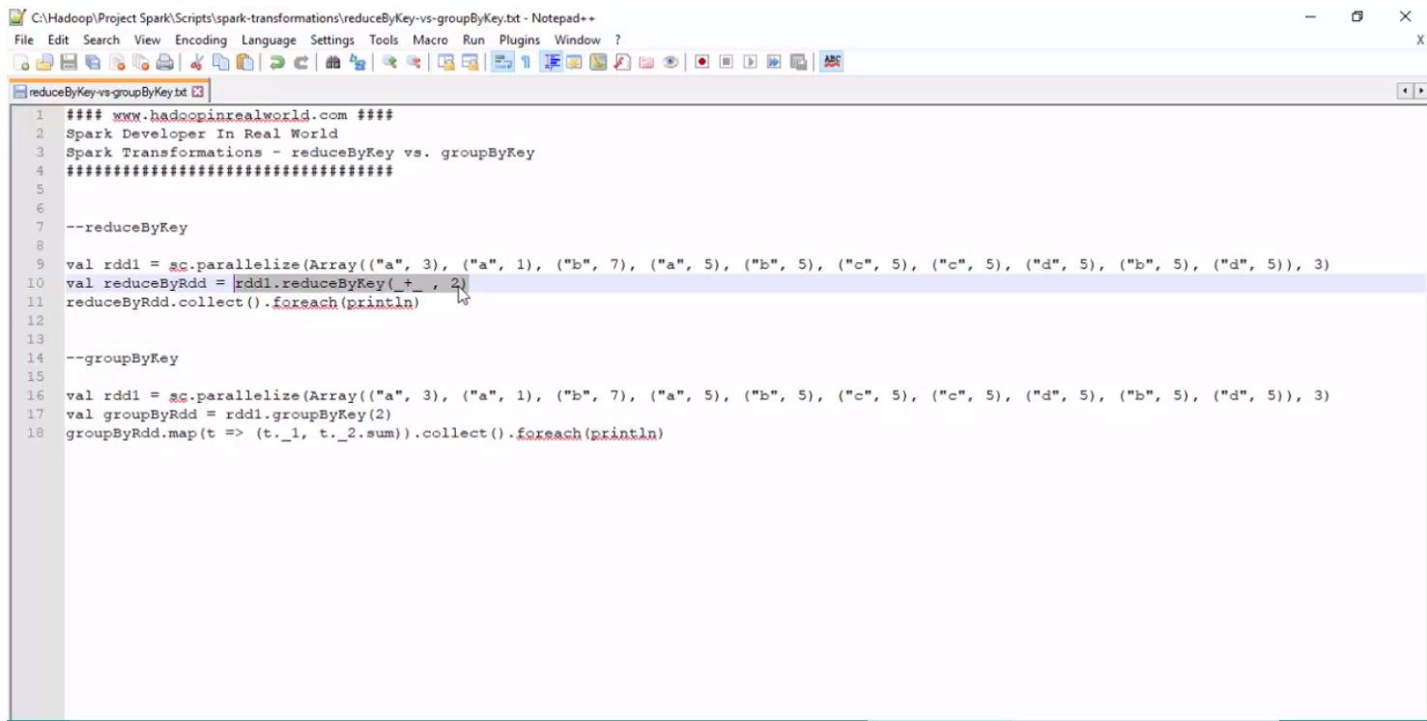
Reduce By Key и Group By Key

Slide 38
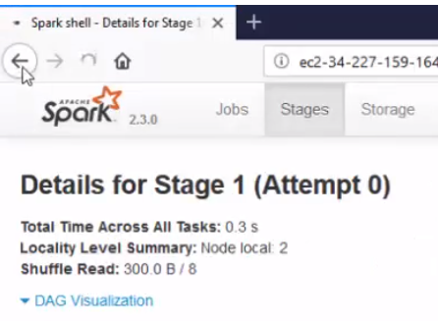
Reduce By Key и Group By Key

Slide 39
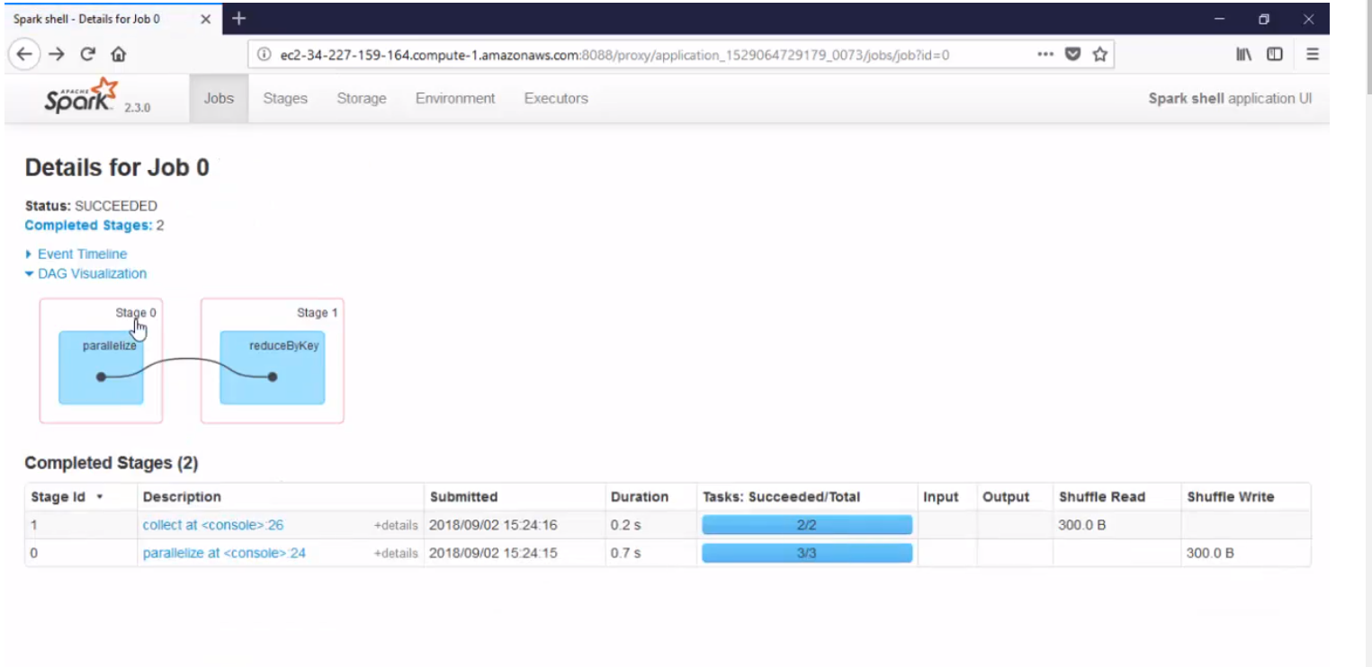
Reduce By Key и Group By Key

Slide 40
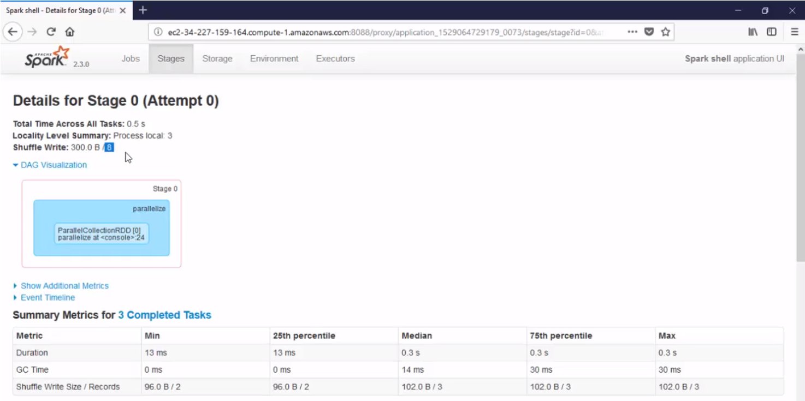
Reduce By Key и Group By Key

Slide 41
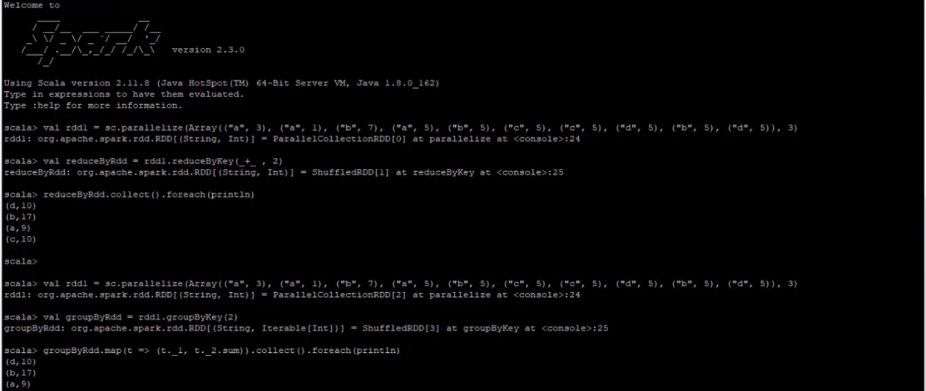
Reduce By Key и Group By Key

Slide 42
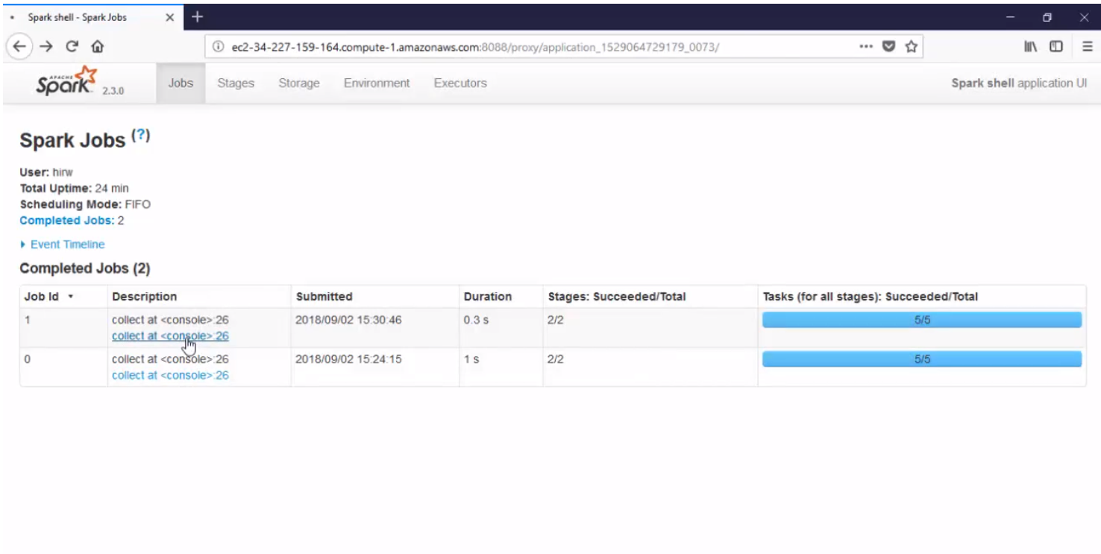
Reduce By Key и Group By Key

Slide 43
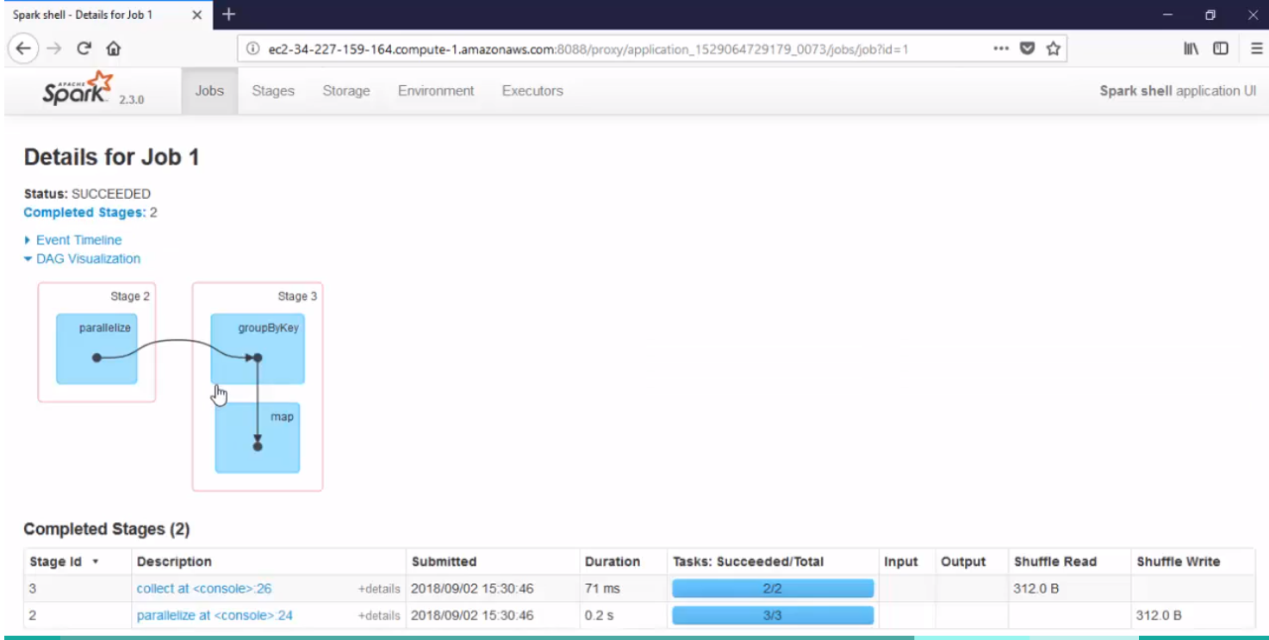
Reduce By Key и Group By Key

Slide 44
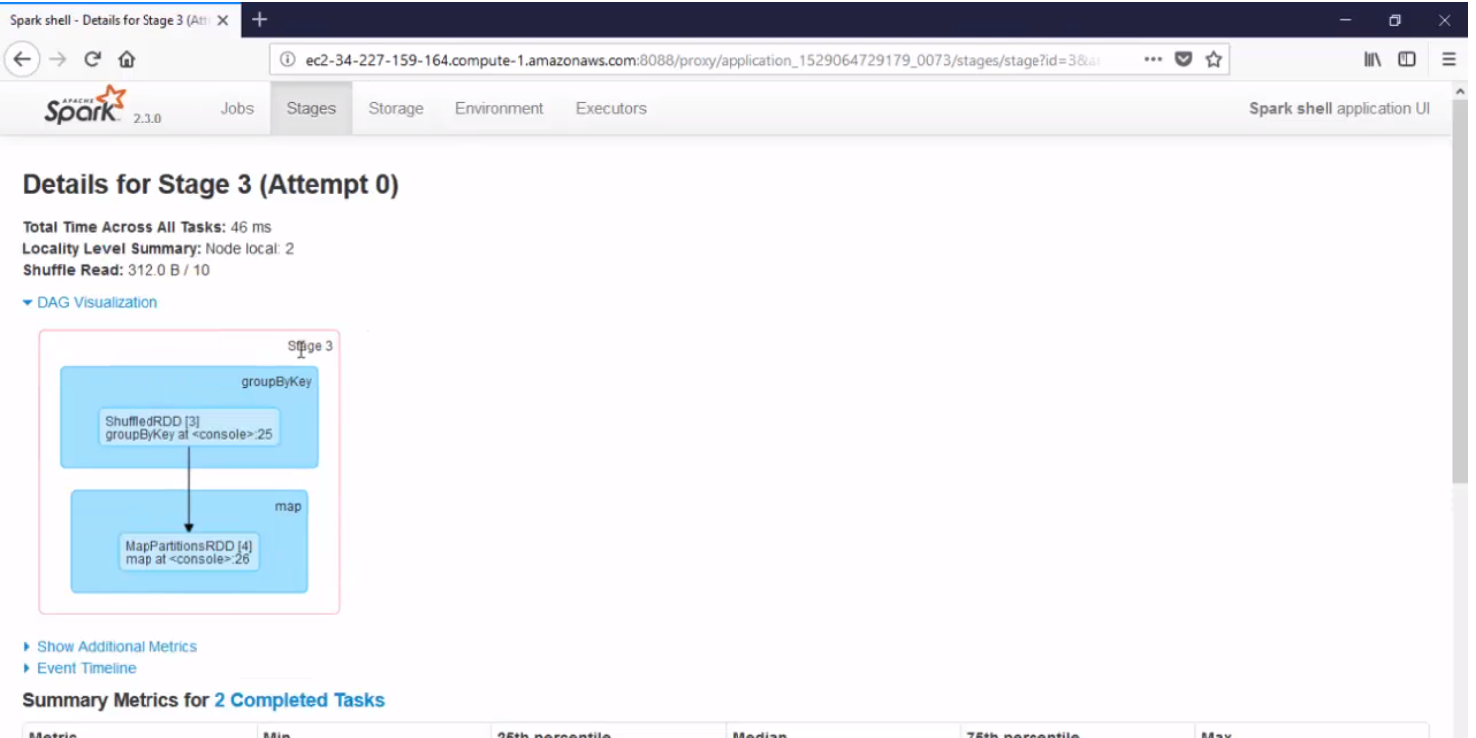
Reduce By Key и Group By Key

Slide 45
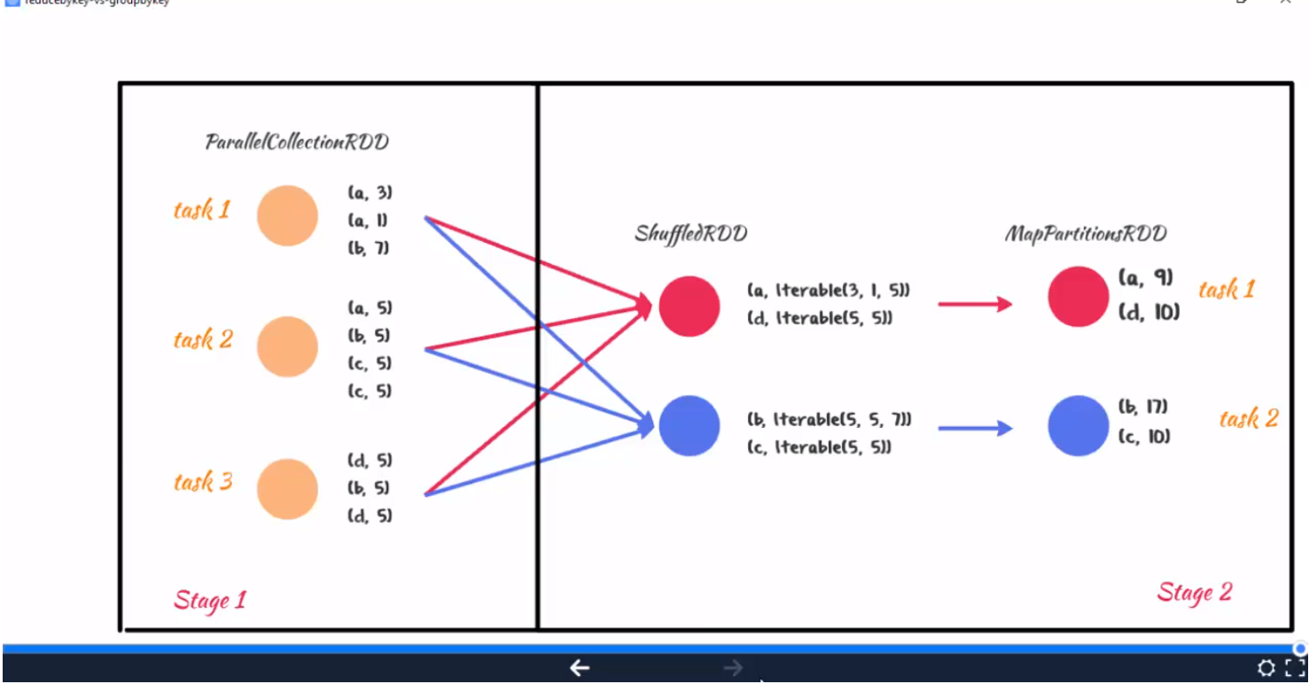
Reduce By Key и Group By Key

Slide 46
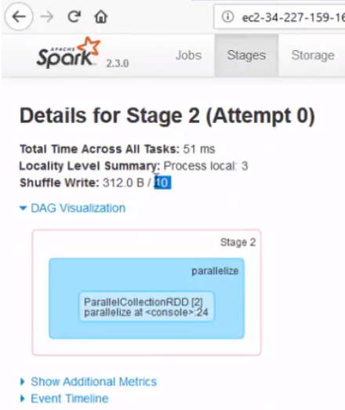
Reduce By Key и Group By Key

Slide 47
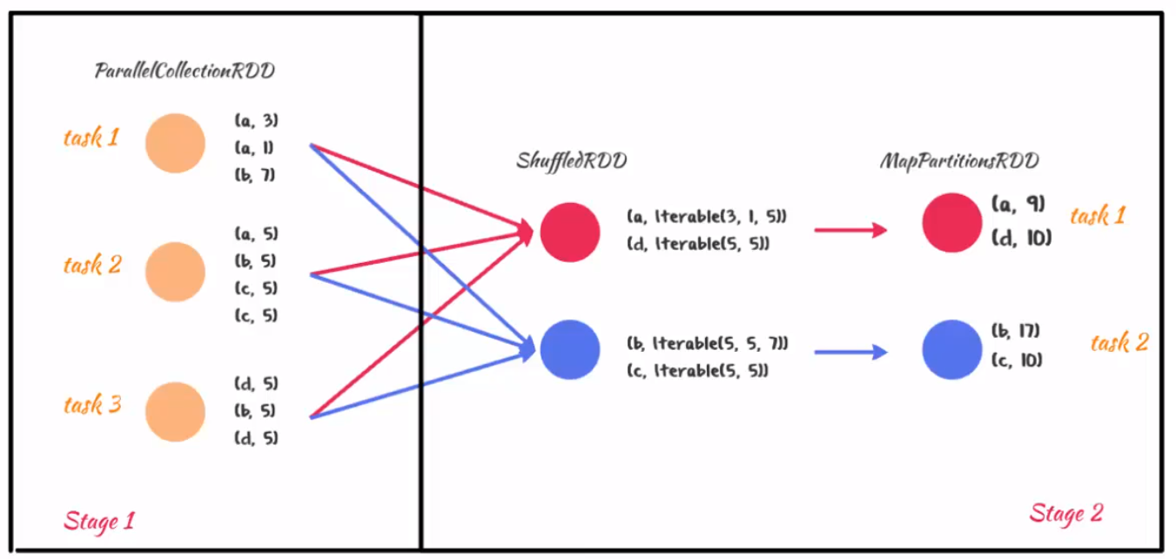
Reduce By Key и Group By Key

